Slide 1

Unit #1
Java Database Connectivity
01CE0411 - 4 Credits
Prepared By
Prof. Ravikumar R Natarajan Assistant Professor, CE Dept.

Slide 2
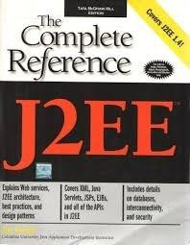
JDBC
Reference Book:
Complete Reference J2EE by James Keogh mcgraw publication
Chapter : 6 and 7
Web Reference: www.javatpoint.com www.tutorialspoint.com

Slide 3
Contents
JDBC Architecture
Types of JDBC Drivers
Introduction to major JDBC Classes and Interface
Creating simple JDBC Application
Types of Statement
Exploring ResultSet Operations
Batch Updates in JDBC
Creating CRUD Application
Using Rowsets Objects
Managing Database Transaction

Slide 4
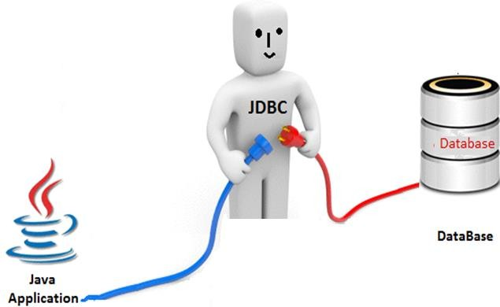
JDBC
JDBC (Java Database Connectivity) is used to connect java application with database.
It provides classes and interfaces to connect or communicate Java application with database.
JDBC is an API used to communicate Java application to database in database independent and platform independent manner.
Example
Oracle
MS Access My SQL
SQL Server Etc.

Slide 5
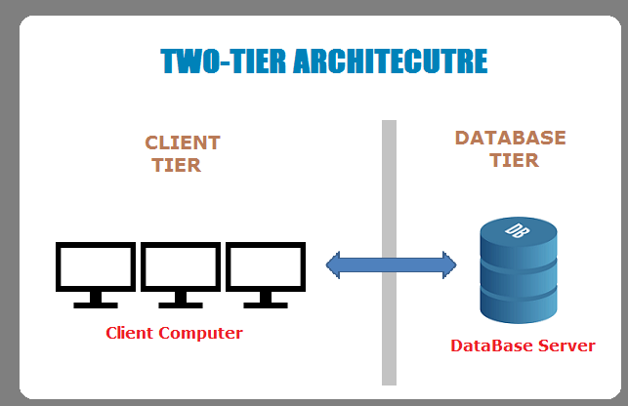

Slide 6
What is an API ?
Application Programming Interface
A set of routines, protocols, and tools for building software applications.
JDBC is an API, which is used in java programming for interacting with database.

Slide 7
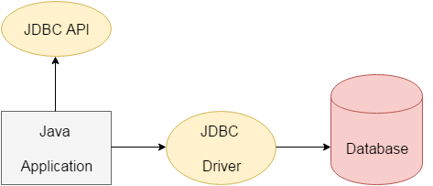
Java Database Connectivity
(JDBC)
Java JDBC is a Java API to connect and execute query with the database. JDBC (Java Database Connectivity) API uses JDBC drivers to connect with the database.
We can use JDBC API to access tabular data stored into any relational database.

Slide 8
Why JDBC
Before JDBC, ODBC API was the database API to connect and execute query with the database. But, ODBC (Open Database Connectivity) API uses ODBC driver which is written in C language (i.e. platform dependent and unsecured). That is why Java has defined its own API (JDBC API) that uses JDBC drivers (written in Java language).
We can use JDBC API to handle database using Java program and can perform following activities:
Connect to the database
Execute queries and update statements to the database
Retrieve the result received from the database.

Slide 9
JDBC Architecture
A Java program that runs stand alone in a client or server.
It provides
interfaces to
classes & connect or
Java Application
communicate Java
application with database.
JDBC API
This class manages a list of database drivers.
It ensures that the correct driver is used to access each data source.
This interface handles the communications with the database
JDBC Driver
Manager
JDBC
Driver
JDBC
Driver
JDBC
Driver
Database is a collection of organized information
ODBC
Data Source
Oracle
SQL
Server

Slide 10
JDBC Drivers
JDBC Driver is a software component that enables java application to interact with the database. There are 4 types of JDBC drivers:
JDBC-ODBC bridge driver (Type – 1)
Native-API driver (partially java driver) (Type – 2)
Network Protocol driver (fully java driver) (Type – 3)
Thin driver (fully java driver) (Type – 4)

Slide 11
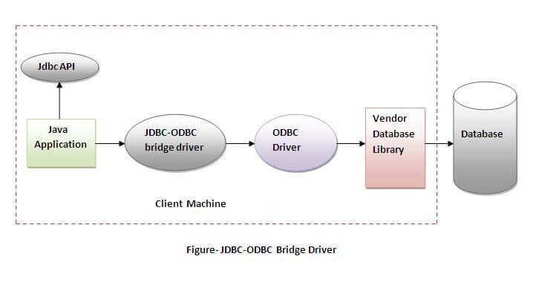
1) JDBC-ODBC bridge driver
The JDBC-ODBC bridge driver uses ODBC driver to connect to the database.
The JDBC- ODBC bridge driver converts JDBC method calls into the ODBC function calls. This is now discouraged because of thin driver.
In Java 8, the JDBC-ODBC Bridge has been removed.

Slide 12
1) JDBC-ODBC bridge driver
Oracle does not support the JDBC-ODBC Bridge from Java 8. Oracle recommends that you use JDBC drivers provided by the vendor of your database instead of the JDBC-ODBC Bridge.
Advantages:
easy to use.
can be easily connected to any database.
Disadvantages:
Performance degraded because JDBC method call is converted
into the ODBC function calls.
The ODBC driver needs to be installed on the client machine.

Slide 13
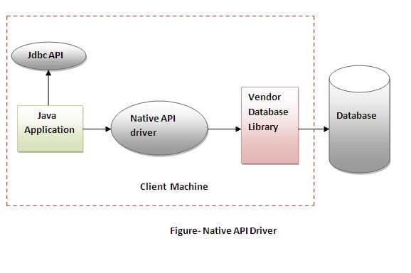
2) Native-API Driver
The Native API driver uses the client-side libraries of the database. The driver converts JDBC method calls into native calls of the database API. It is not written entirely in java.

Slide 14
2) Native-API Driver
Advantage:
Performance upgraded than JDBC-ODBC bridge driver.
Disadvantage:
The Native driver needs to be installed on the each client machine.
The Vendor client library needs to be installed on client machine.

Slide 15
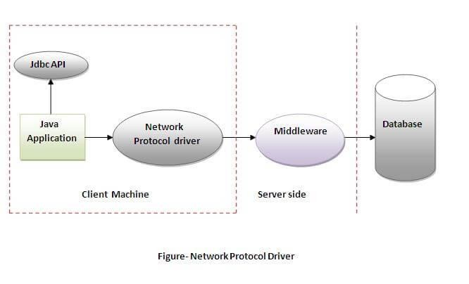
3) Network Protocol driver
The Network Protocol driver uses middleware (application server) that converts JDBC calls directly or indirectly into the vendor-specific database protocol. It is fully written in java.

Slide 16
3) Network Protocol driver
Advantage:
No client side library is required because of application server that can perform many tasks like auditing, load balancing, logging etc.
Disadvantages:
Network support is required on client machine.
Requires database-specific coding to be done in the middle tier.
Maintenance of Network Protocol driver becomes costly because it requires database-specific coding to be done in the middle tier.

Slide 17
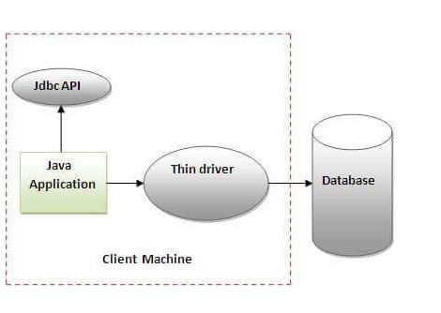
4) Thin driver
The thin driver converts JDBC calls directly into the vendor-specific database protocol. That is why it is known as thin driver. It is fully written in Java language.

Slide 18
4) Thin driver
Advantage:
Better performance than all other drivers.
No software is required at client side or server side.
Disadvantages:
Drivers depend on the Database.

Slide 19
JDBC with Different RDBMS
RDBMS | JDBC Driver Name | URL Format
MySQL | com.mysql.jdbc.Driver | jdbc:mysql://hostname/ databaseName
ORACLE | oracle.jdbc.driver.OracleDriver | jdbc:oracle:thin:@hostname:port Number:databaseName
DB2 | com.ibm.db2.jdbc.net.DB2Driver | jdbc:db2:hostname:port Number/databaseName
Sybase | com.sybase.jdbc.SybDriver | jdbc:sybase:Tds:hostname: port Number/databaseName
SQLite | org.sqlite.JDBC | jdbc:sqlite:C:/sqlite/db/databaseName
SQLServer | com.Microsoft.sqlserver.jdbc.SQLServerDriver | jdbc:Microsoft:sqlserver://hostname:1433;DatabaseName
Notes:
TDS – Tabular Data Stream

Slide 20
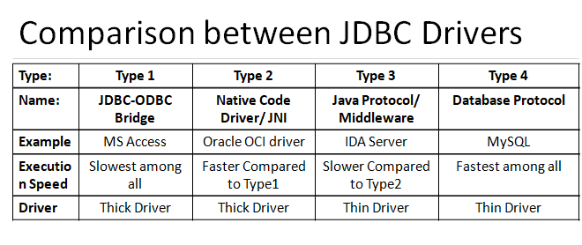

Slide 21
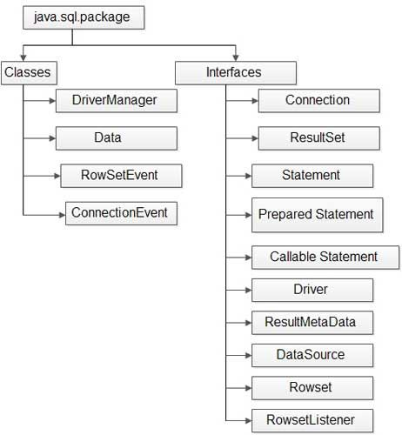
Major Classes and Interfaces in JDBC
Classes and Interfaces in
sql package

Slide 22
Connectivity with 5 Steps
There are 5 steps to connect any java application with the database using JDBC. These steps are as follows:
Register the driver class
Creating connection
Creating statement
Executing queries
Closing connection

Slide 23
1) Register the driver class
The forName() method of Class class is used to register the driver class.
This method is used to dynamically load the driver class.
Syntax of forName() method
public static void forName(String className)throws ClassNotFoundException
Example to register the OracleDriver class
Here, Java program is loading oracle driver to esteblish database
connection.
Class.forName("com.mysql.jdbc.Driver");

Slide 24
2) Create the connection object
The getConnection() method of DriverManager class is used to establish
connection with the database.
Syntax of getConnection() method
public static Connection getConnection(String url)throws SQLException
public static Connection getConnection(String url,String name, String password) throws SQLException
Example to establish connection with the Oracle database
Connection con=DriverManager.getConnection(
"jdbc:mysql://hostname/ databaseName", "root","password");

Slide 25
3) Create the Statement object
The createStatement() method of Connection interface is used to create statement. The object of statement is responsible to execute queries with the database.
Syntax of createStatement() method
public Statement createStatement()throws SQLException
Example to create the statement object
Statement stmt=con.createStatement();

Slide 26
4) Execute the query
The executeQuery() method of Statement interface is used to execute queries to the database. This method returns the object of ResultSet that can be used to get all the records of a table.
Syntax of executeQuery() method
public ResultSet executeQuery(String sql)throws SQLException
Example to execute query
ResultSet rs=stmt.executeQuery("select * from emp");
while(rs.next()){ System.out.println(rs.getInt(1)+" rs.getString(“dept_name”));
}
"+rs.getString(2) + “ “ +

Slide 27
5) Close the connection object
By closing connection object statement and ResultSet will be closed automatically. The close() method of Connection interface is used to close the connection.
Syntax of close() method
public void close()throws SQLException
Example to close connection
con.close();

Slide 28
JDBC MySQL Example
Create database : MU
Table : emp ( emp_id number, name varchar(30), dept varchar2(20));
Insert records
Display records from table

Slide 29
Creating simple JDBC Application
Demo
Netbeans with MySQL database
Refer JDBC_demo

Slide 30
Activity
https://www.menti.com/almkcrdxsxmx

Slide 31

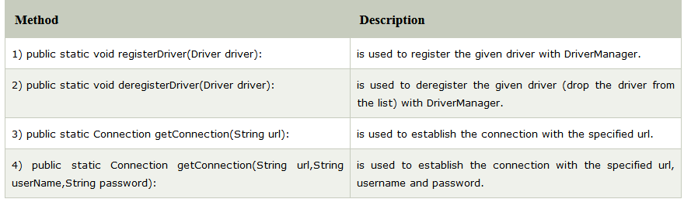
DriverManager class
The DriverManager class acts as an interface between user and drivers. It keeps track of the drivers that are available and handles establishing a connection between a database and the appropriate driver. The DriverManager class maintains a list of Driver classes that have registered themselves by calling the method DriverManager.registerDriver().
Useful methods of DriverManager class

Slide 32
Connection Interface
A Connection is the session between java application and database. The Connection interface is a factory of Statement, PreparedStatement, and DatabaseMetaData i.e. object of Connection can be used to get the object of Statement and DatabaseMetaData. The Connection interface provide many methods for transaction management like commit(), rollback() etc.
public Statement createStatement(): creates a statement object that can be used to execute SQL queries.
public Statement createStatement(int resultSetType, int resultSetConcurrency): Creates a Statement object that will generate ResultSet objects with the given type and concurrency.
public void setAutoCommit(boolean status): is used to set the commit status. By default it is true.
public void commit(): saves the changes made since the previous commit/rollback
permanent.
public void rollback(): Drops all changes made since the previous commit/rollback.
public void close(): closes the connection and Releases a JDBC resources immediately.

Slide 33
Statement Interface
The Statement interface provides methods to execute queries with the database. The statement interface is a factory of ResultSet i.e. it provides factory method to get the object of ResultSet.
Commonly used methods of Statement interface:
The important methods of Statement interface are as follows:
public ResultSet executeQuery(String sql): is used to execute SELECT query. It
returns the object of ResultSet.
public int executeUpdate(String sql): is used to execute specified query, it may be create, drop, insert, update, delete etc.
public boolean execute(String sql): is used to execute queries that may return multiple results.
public int[] executeBatch(): is used to execute batch of commands.

Slide 34
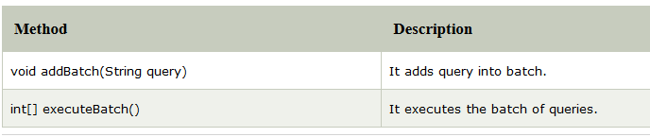
Batch Processing in JDBC
Methods of Statement interface
The required methods for batch processing are given below:
Batch Processing follows following steps:
Load the driver class Create Connection
Create Statement
Add query in the batch
Execute Batch
Close Connection
Check Program → executeBatch_demo

Slide 35
ResultSet Interface
The object of ResultSet maintains a cursor pointing to a row of a table. Initially, cursor points to before the first row.
But we can make this object to move forward and backward direction by passing either TYPE_SCROLL_INSENSITIVE or TYPE_SCROLL_SENSITIVE in createStatement(int,int) method as well as we can make this object as updatable by:
Statement stmt = con.createStatement(ResultSet.TYPE_SCROLL_INSENSITIVE, ResultSet.CONCUR_UPDATABLE);
Notes:
https://www.digitalocean.com/community/tutorials/java-resultset

Slide 36
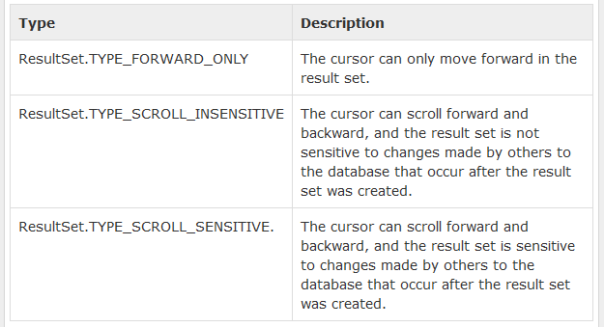
Types of ResultSet
The possible RSType are given below. If you do not specify any ResultSet type, you will automatically get one that is TYPE_FORWARD_ONLY.

Slide 37
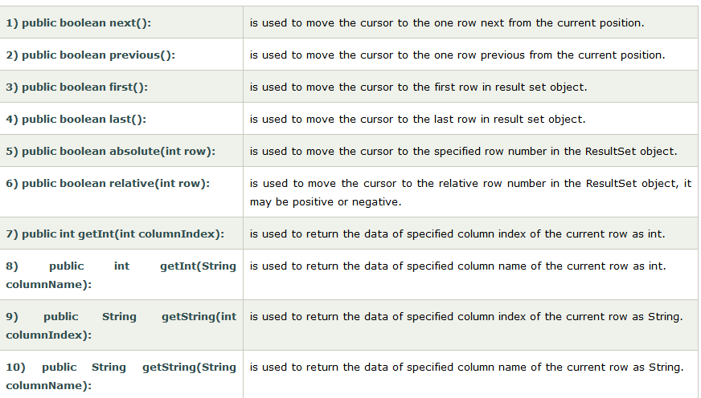
ResultSet Interface Methods

Slide 38
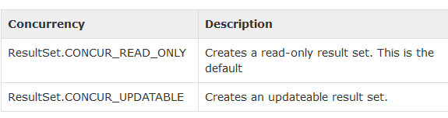
Concurrency of Result Set
The concurrency of the ResultSet object determines whether its contents can be updated or not.
If you do not specify any Concurrency type, you will automatically get one that is CONCUR_READ_ONLY.

Slide 39

JDBC MySQL Example : executeUpdate( )
In Previous code change the SQL query in the executeQuery
In Previous code change the SQL query in the executeQuery
ResultSet rs=stmt.executeQuery("select * from emp");
int i = stmt. executeUpdate(“create TABLE ss_table (Roll no int, Name
Varchar(20))");
if(i==0)
System.out.println("Table created"); else
System.out.println("Table Not created");

Slide 40
Statement Example : Execute( ), executeUpdate( ), executeQuery( )
Check Program → statement_demo
Check Program → executeBatch_demo

Slide 41
Activity
https://www.menti.com/alj3tkji414s

Slide 42
Types of Statements
There are three types of statements in JDBC namely:
Statement
Prepared Statement
Callable statement.
Let’s explore all of these in next slide…

Slide 43

1. Statement
Statement
The Statement interface represents the static SQL statement. It helps you to create a general purpose SQL statements using Java.
Creating a statement
You can create an object of this interface using the createStatement() method of the
Connection interface.
Create a statement by invoking the createStatement() method as shown below.
stmt = conn.createStatement();
String sql1 = "update demo set Enroll=999 where Enroll=1213";
int rows = stmt.executeUpdate(sql1);

Slide 44

1. Statement
Executing the Statement object
Once you have created the statement object you can execute it using one of the execute methods namely, execute(), executeUpdate() and, executeQuery().
execute(): This method is used to execute SQL DDL statements, it returns a boolean value specifying whether the ResultSet object can be retrieved.
executeUpdate(): This method is used to execute statements such as insert, update, delete. It returns an integer value representing the number of rows affected.
executeQuery(): This method is used to execute statements that returns tabular data (example SELECT statement). It returns an object of the class ResultSet.
Refer Example: Statement_Demo

Slide 45
2. Prepared Statement
The PreparedStatement interface extends the Statement interface. It represents a precompiled SQL statement which can be executed multiple times. This accepts parameterized SQL queries and you can pass 0 or more parameters to this query.
Initially, this statement uses place holders “?” instead of parameters, later on, you can pass arguments to these dynamically using the setXXX() methods of the PreparedStatement interface.

Slide 46
2. Prepared Statement
Creating a PreparedStatement
You can create an object of the PreparedStatement (interface) using the prepareStatement() method of the Connection interface. This method accepts a query (parameterized) and returns a PreparedStatement object.
When you invoke this method the Connection object sends the given query to the database to compile and save it. If the query got compiled successfully then only it returns the object.
To compile a query, the database doesn’t require any values so, you can use (zero or more) placeholders (Question marks “?”) in the place of values in the query.
Check example in next slide…

Slide 47

2. Prepared Statement
For example, if you have a table named Employee in the database created using the
following query:
CREATE TABLE Employee(Name VARCHAR(255), Salary INT NOT NULL, Location VARCHAR(255));
Then, you can use a PreparedStatement to insert values into it as shown below.
//Creating a Prepared Statement
String query="INSERT INTO Employee(Name, Salary, Location)VALUES(?, ?, ?)"; Statement pstmt = con.prepareStatement(query);

Slide 48

2. Prepared Statement
Setting values to the place holders
The PreparedStatement interface provides several setter methods such as setInt(), setFloat(), setArray(), setDate(), setDouble() etc.. to set values to the place holders of the prepared statement.
These methods accepts two arguments one is an integer value representing the placement index of the place holder and the other is an int or, String or, float etc… representing the value you need to insert at that particular position.
Once you have created a prepared statement object (with place holders) you can set values to the place holders of the prepared statement using the setter methods as shown below:
pstmt.setString(1, "Amit"); pstmt.setInt(2, 3000); pstmt.setString(3, "Hyderabad");

Slide 49
2. Prepared Statement
Executing the Prepared Statement
Once you have created the PreparedStatement object you can execute it using one of the execute() methods of the PreparedStatement interface namely, execute(), executeUpdate() and, executeQuery().
execute(): This method executes normal static SQL statements in the current prepared statement object and returns a boolean value.
executeQuery(): This method executes the current prepared statement and
returns a ResultSet object.
executeUpdate(): This method executes SQL DML statements such as insert update or delete in the current Prepared statement. It returns an integer value representing the number of rows affected.
Refer Example: Prepare_Statement

Slide 50
3. Callable Statement
The CallableStatement interface provides methods to execute stored procedures. Since the JDBC API provides a stored procedure SQL escape syntax, you can call stored procedures of all RDBMS in a single standard way.
Creating a CallableStatement
You can create an object of the CallableStatement (interface) using the prepareCall() method of the Connection interface.
This method accepts a string variable representing a query to call the stored procedure and
returns a CallableStatement object.
A CallableStatement can have input parameters or, output parameters or, both. To pass input parameters to the procedure call you can use place holder and set values to these using the setter methods (setInt(), setString(), setFloat()) provided by the CallableStatement interface.
Suppose, you have a procedure name myProcedure in the database you can prepare a callable statement as: //Preparing a CallableStatement CallableStatement
cstmt = con.prepareCall("{call myProcedure(?, ?, ?)}");

Slide 51

3. Callable Statement
Setting values to the input parameters
You can set values to the input parameters of the procedure call using the setter methods.
These accept two arguments one is an integer value representing the placement index of the input parameter and the other is an int or, String or, float etc… representing the value you need to pass an input parameter to the procedure.
Note: Instead of index you can also pass the name of the parameter in String format. cstmt.setString(1, "Raghav");
cstmt.setInt(2, 3000);
cstmt.setString(3, "Hyderabad");

Slide 52
3. Callable Statement
Executing the Callable Statement
Once you have created the CallableStatement object you can execute it using one of the execute() method.
cstmt.execute();
Refer Example: Callable_Statement_IN

Slide 53
Instance of Callable Statement
The prepareCall() method of Connection interface returns the instance of CallableStatement. Syntax is given below:
public CallableStatement prepareCall("{ call procedurename(?,?...?)}");
The example to get the instance of CallableStatement is given below:
CallableStatement stmt=con.prepareCall("{call myprocedure(?,?)}");
It calls the procedure myprocedure that receives 2 arguments.

Slide 54
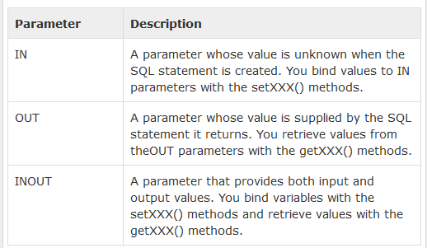
Parameters used with Callable Statement
Three types of parameters exist: IN, OUT, and INOUT. The PreparedStatement object only uses the IN parameter. The CallableStatement object can use all the three.
Here are the definitions of each −

Slide 55
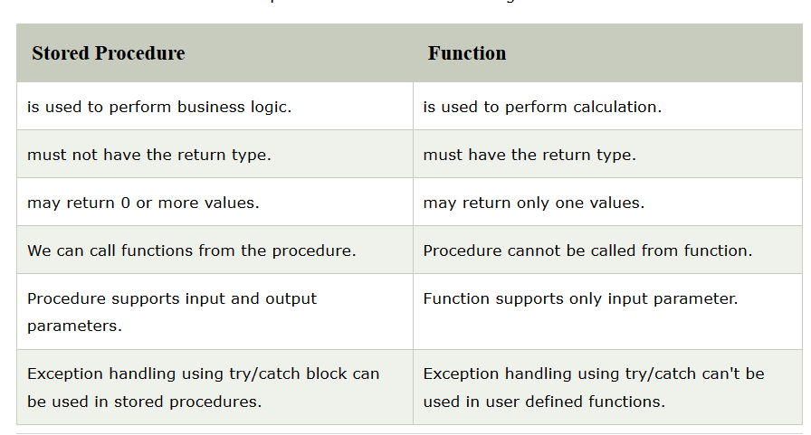
Difference between stored
Procedure and function

Slide 56
PL/SQL Function and Procedure
Just as a Connection object creates the Statement and PreparedStatement objects, it also creates the CallableStatement object, which would be used to execute a call to a database stored procedure.
Create Procedure in MySQL:
DELIMITER $$
DROP PROCEDURE IF EXISTS `MU`.`getStudentName` $$ CREATE PROCEDURE `MU`.`getStudentName`
(IN VAR_SID INT, OUT VAR_SNAME VARCHAR(20)) BEGIN
SELECT sname INTO VAR_SNAME FROM student
WHERE SID= VAR_SID;
END $$ DELIMITER ;
Check Programs → Callable_Statement

Slide 57
Transaction Management in JDBC
Transaction represents a single unit of work.
The ACID properties describes the transaction management well. ACID stands for Atomicity, Consistency, isolation and durability.
Atomicity means either all successful or none.
Consistency ensures bringing the database from one consistent state to another consistent state.
Isolation ensures that transaction is isolated from other transaction.
Durability means once a transaction has been committed, it will remain so, even in the event of errors, power loss etc.

Slide 58
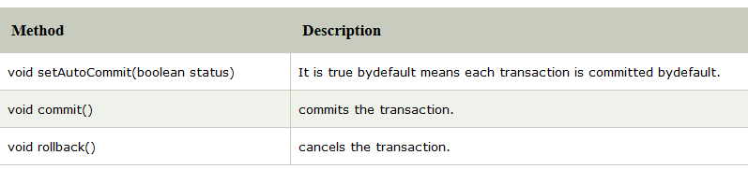
Transaction Management in JDBC
In JDBC, Connection interface provides methods to manage transaction.
Check Program → TransactionDemo

Slide 59
JDBC Rowset Interface
The instance of RowSet is the java bean component because it has properties and java bean notification mechanism. It is introduced since JDK 5.
It is the wrapper of ResultSet. It holds tabular data like ResultSet but it is easy and
flexible to use.
The implementation classes of RowSet interface are as follows:
JdbcRowSet
CachedRowSet
WebRowSet
JoinRowSet
FilteredRowSet
Check Programs → RowsetExample,
RowsetExample1
Advantage of RowSet
It is easy and flexible to use
It is Scrollable and Updatable by default

Slide 60
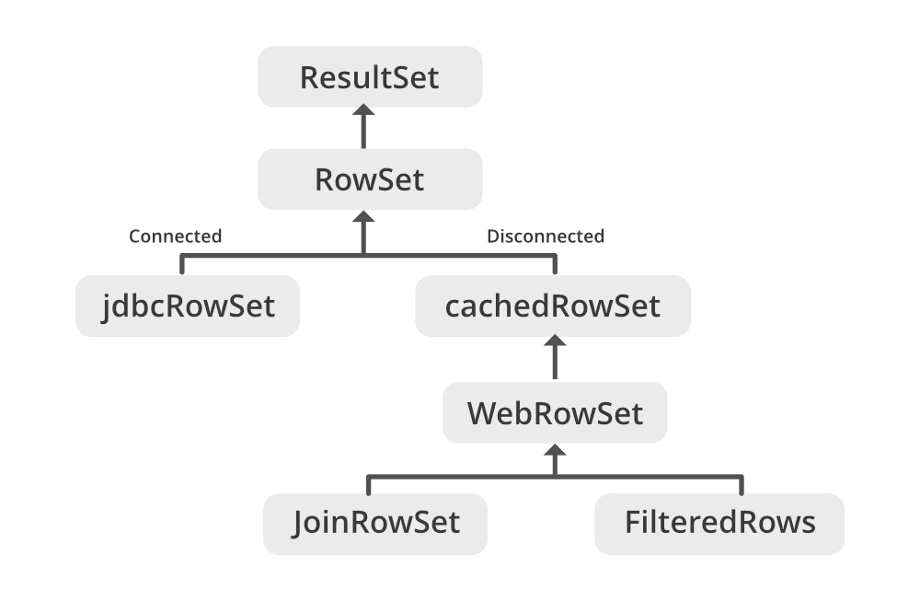
JDBC Rowset Interface

Slide 61
JDBC Rowset Interface
import javax.sql.rowset.JdbcRowSet; import javax.sql.rowset.RowSetProvider;
public class RowSetExample {
public static void main(String[] args) throws Exception {
Class.forName("com.mysql.jdbc.Driver");
//Creating and Executing RowSet
JdbcRowSet rowSet = RowSetProvider.newFactory().createJdbcRowSet();
rowSet.setUrl("jdbc:mysql://localhost/MU");
rowSet.setUsername("root");
rowSet.setPassword("");
rowSet.setCommand("select * from student");
rowSet.execute();
while (rowSet.next()) { // Generating cursor Moved event
System.out.println("Student Id: " + rowSet.getString(1));
} } }

Slide 62
JDBC RowSet vs ResultSet
ResultSet | RowSet
A ResultSet always maintains connection with the database. | A RowSet can be connected, disconnected from the database.
It cannot be serialized. | A RowSet object can be serialized.
ResultSet object cannot be passed other over network. | You can pass a RowSet object over the network.
ResultSet object is not a JavaBean object You can create/get a result set using the executeQuery() method. | ResultSet Object is a JavaBean object. You can get a RowSet using the RowSetProvider.newFactory().createJdb cRowSet() method.
By default, ResultSet object is not scrollable or, updatable. | By default, RowSet object is scrollable and updatable.

Slide 63
Mini Project 1
Using JDBC connection, Create CRUD Application and perform Insert, select, update and delete operations.
MYSQL table should have minimum four columns and 5 records.

Slide 64
Summary
JDBC Architecture
Types of JDBC Drivers
Introduction to major JDBC Classes and Interface
Creating simple JDBC Application
Types of Statement
Exploring ResultSet Operations
Batch Updates in JDBC
Creating CRUD Application
Using Rowsets Objects
Managing Database Transaction

Slide 65
Up Next
Swing features
Swing Containers
Jframe
Jpanel
JWindow
Swing components : JLabel, ImageIcon, JTextField, JButton, JToggeleButton, JCheckBox, JRadioButton, JTabbedPane, JScrollPane, JList, JComboBox, JTree, JTable
Layout managers
Event model in Java
Event classes
Event listeners
Adapter classes

Slide 66
END OF UNIT-1

